Slide 1

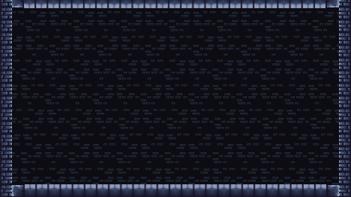
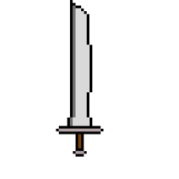

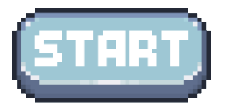
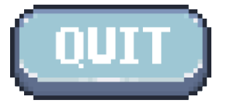
Game opens to main menu screen.

Slide 2

The player chooses “start”.

Slide 3
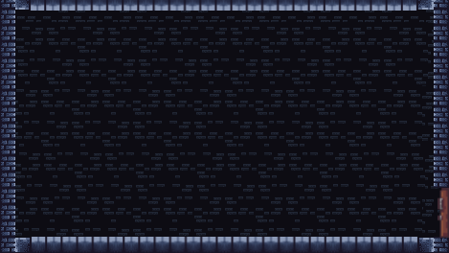

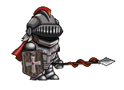
A level is generated, and the player is shown their character in a random starting room.

Slide 4
The player can interact with doors to move from room to room.

Slide 5
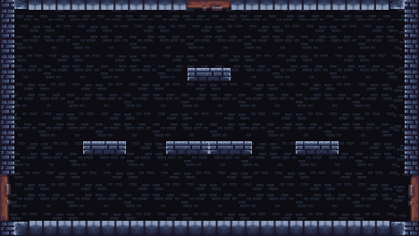
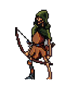
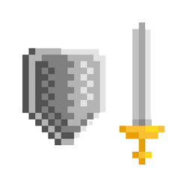
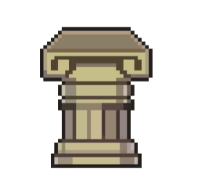
Contents of each room are also random. This room has an enemy, some platforms, a weapon, and a few crates.

Slide 7
The player jumps onto the platforms and defeats the enemy.

Slide 9

Crates can be destroyed. Each crate has a chance to drop coins or health items. This one dropped a coin.

Slide 10
Collecting coins will increase the player’s score at the end.

Slide 11
Weapons can be found on pedestals like this one. Different weapons will allow the player character to attack in different ways.

Slide 12
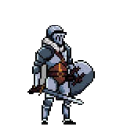
The player now has a sword and shield.

Slide 14
Doors are not limited to only left and right. The player may also move through paths above and below.

Slide 15
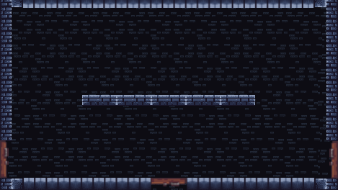
Another example of a possible room. This one contains a different pattern of platforms, another basic enemy, and a chest.

Slide 16
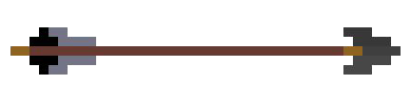
The enemy fires an arrow at the player.

Slide 17
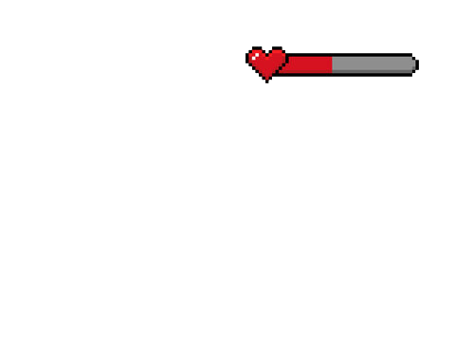
The player gets hit and their health goes down.

Slide 18
As long as the player’s health is not 0, they can continue to play like normal, attacking and defeating enemies.

Slide 20
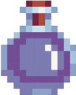
Chests can be opened to get items which change the player’s stats, making them more powerful.

Slide 21

This one gave the player a potion that increased how much damage they do when attacking.

Slide 22
The player moves to the door on the left and walks through it.

Slide 23
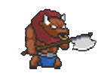
Each generated level will have a boss room. Bosses are tougher enemies that must be beaten before progressing to the next level.

Slide 24
The game will continue until the player dies. The goal is to get through as many levels as possible and increase their score.

Slide 25
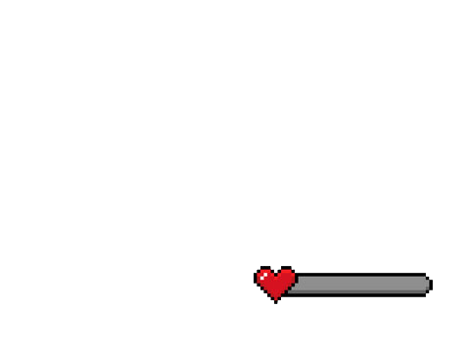


The player dropped to 0 health and died. The player character falls to the ground and their score is shown.

Slide 26
The screen fades to black

Slide 27
The screen fades to black

Slide 28
The game ends and the player is shown the main menu where they can begin again or quit the game.

